Slide 1

Coursera data science capstone
Finding the ideal location for a business in a covid-affected usa

Slide 2
Finding the ideal location
Covid has affected business globally and domestically across the world
Does not make sense to open a business in an area that has been and will continue to be hard hit by Covid
Task is to find a state that is amenable to business and has dealt with Covid successfully
In addition, finding a location within the state that meets the business’ needs
Physical activity and wellbeing venues nearby
Located in a busy business district, ideally

Slide 3
Data acquisition and cleaning
Covid-19 Data for the US:
Historical Data for US - https://raw.githubusercontent.com/nytimes/covid-19-data/master/us.csv
Historical Data for States - https://raw.githubusercontent.com/nytimes/covid-19-data/master/us-states.csv
Historical Data by County - https://raw.githubusercontent.com/nytimes/covid-19-data/master/us-counties.csv
Geospatial data for Los Angeles:
https://apps.gis.ucla.edu/geodata/sr_Latn/dataset/los-angeles-county-neighborhoods/resource/6cde4e9e-307c-477d-9089-cae9484c8bc1
Location and venue data from Foursquare

Slide 4
Data acquisition and cleaning
Census population data for US States extrapolated using average population growth since last census
State Codes added to dataset for compatibility with Plotly, courtesy of Roger Allen on Github
Outlying neighbourhoods that are not suitable for big business locations were removed from the dataset
E.g. Antelope Valley, Santa Monica Mountains

Slide 5
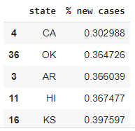
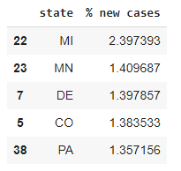
Ideal state – states with the most/least new cases as a percentage of population from apr-jun 2021

Slide 6
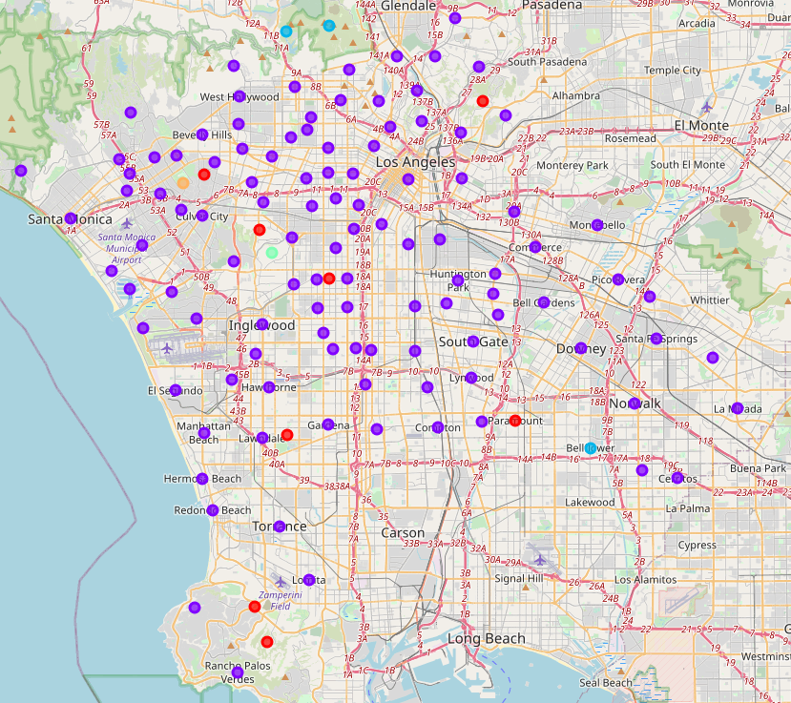
Los angeles map after being clustered

Slide 7
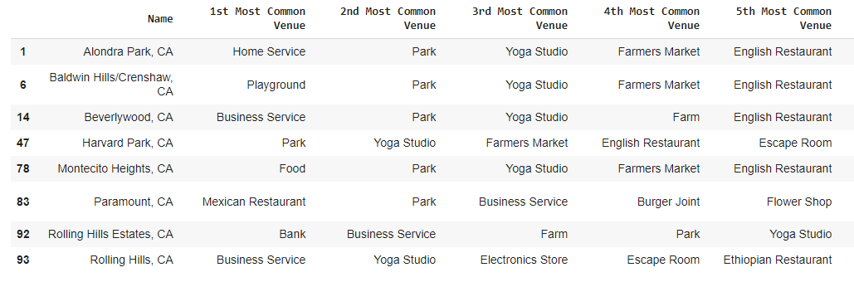
Most common venues in cluster 1

Slide 8
conclusion
Neighbourhoods in cluster 1 most suitable for businesses that seek physical activity locations
Proximity to Yoga Studios, Parks, Playgrounds
Large number of neighbourhoods clustered in cluster 2 – symptom of problem with model
Model can be improved by modifying k-clustering algorithm or using another algorithm entirely
The model does not take into account other factors that may be important, such as:
Cost of rent for business space
Proximity to competitors that could affect business
Ease of access for parking, or public transport options

